Slide 1
AMP®-Parkinson‘s Disease Progression Prediction Capstone 2
Capstone 2: Maria Meza

Slide 2
Problem Identification

Slide 3
Make an appropriate model that best predicts the progression of Parkinson’s disease by identifying the UPDR ranking

Slide 4
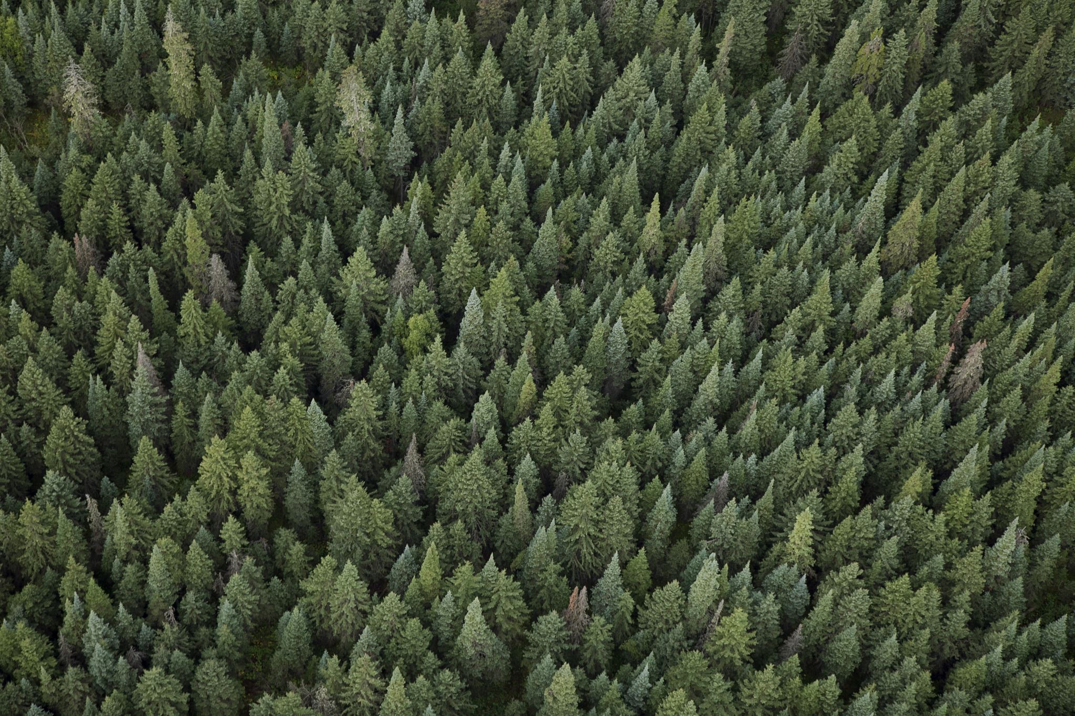
The best model was a GBM without a robust scaler.

Slide 5
Defining Variables

Slide 6

Defining Data
NPX: Protein's occurrence in the sample. ( AKA Protein Abundance).
Peptide Abundance: How much of a peptide appeared in the sample.
Not to be confused with protein abundance!
UniProt : Unique protein ID
UPDRs1-4: The patient's score for the Unified Parkinson's Disease Rating Scale. Different levels cover different symptoms.
UPDR 1: Mood and behavior
UPDR2: Daily Motor Functions
UPDR3: Motor functions
UPDR4: Further Complications

Slide 7
Defining Data
Visit Id: The ID for the visit
Visit Month: The months passed after each visit. Starts at zero.
Patient Id : Unique ID given to each patient
Clinical state on medication: Indicates whether the patient is on medication before being tested for Parkinson’s

Slide 8
EDA

Slide 9
Quantitative Variables:
NPX
Protein Abundance
UPDRs 1-4

Slide 10
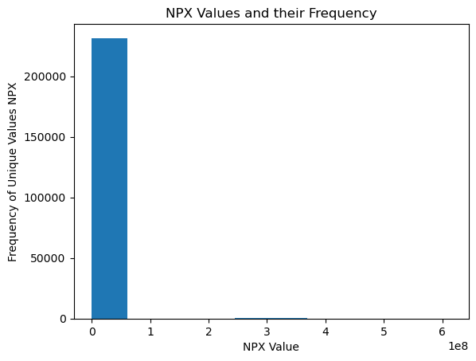
NPX Data has a wide range of values

Slide 11
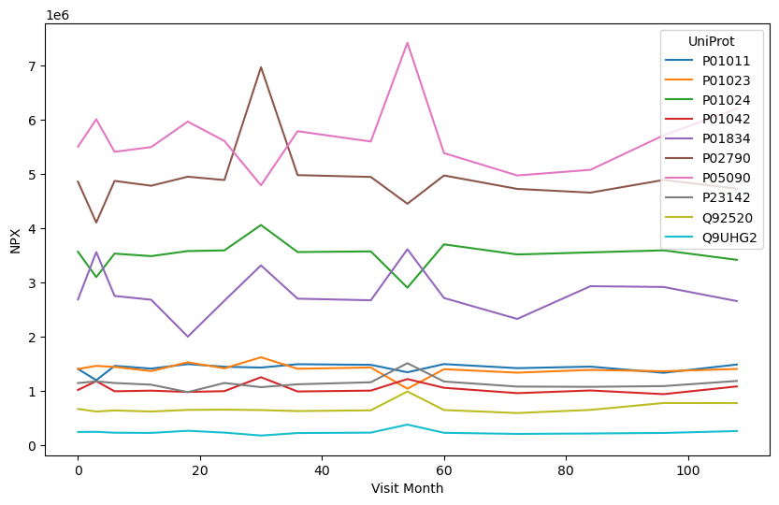
NPX vs Visit Month
The 3 most common proteins over the whole dataset
PO5090
PO2790
PO1024
This Graph looks Similar!!!!
(looks like UPDR Graph)

Slide 12
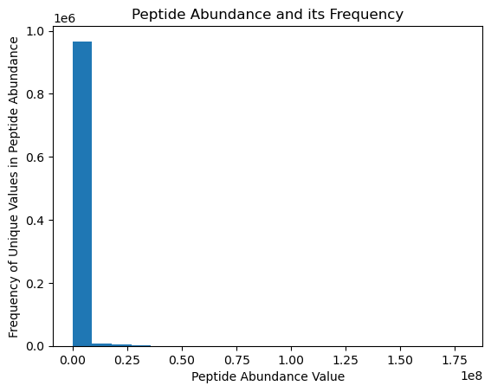
Peptide Abundance Data has a wide range of values

Slide 13
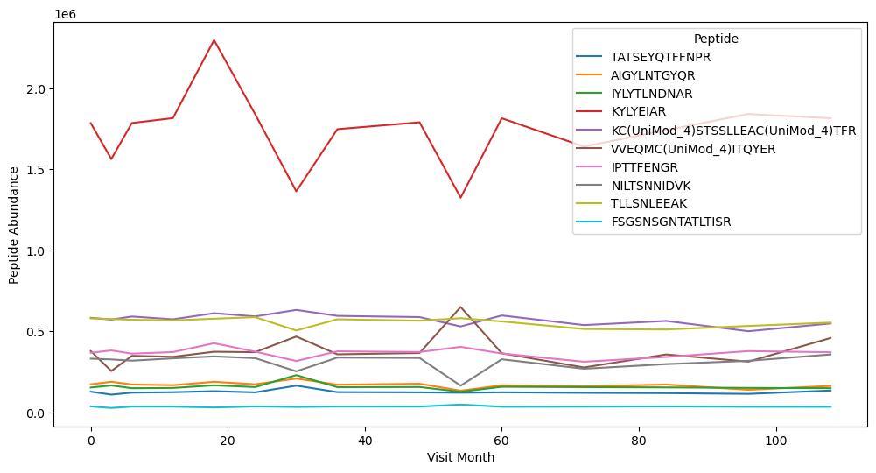
Peptide vs Visit Month
The 3 most common peptides over the whole dataset
KYLYEAIR
KC
TLLSNLEEAK

Slide 14
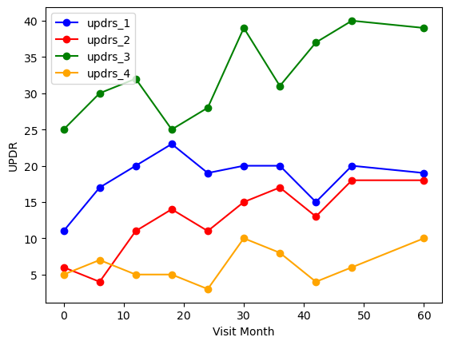
UPDRs1-4
As time progresses there seems to be an increase UPDRs scores. There are some dips.
Could these be medicine related?

Slide 15
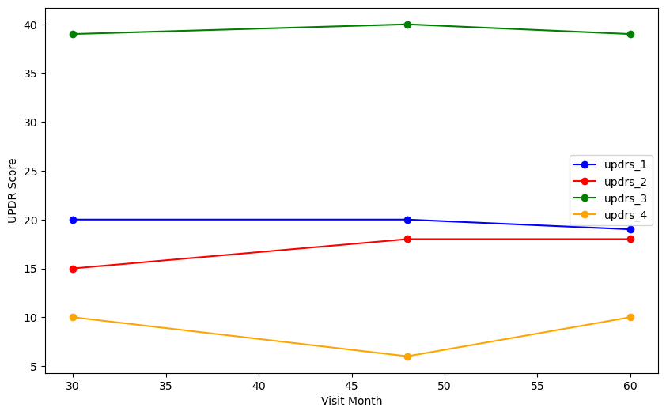
UPDRs1-4: Without Medication and NA values
As expected it was medicine related! The UPDRs scores seem quite constant over time.

Slide 16
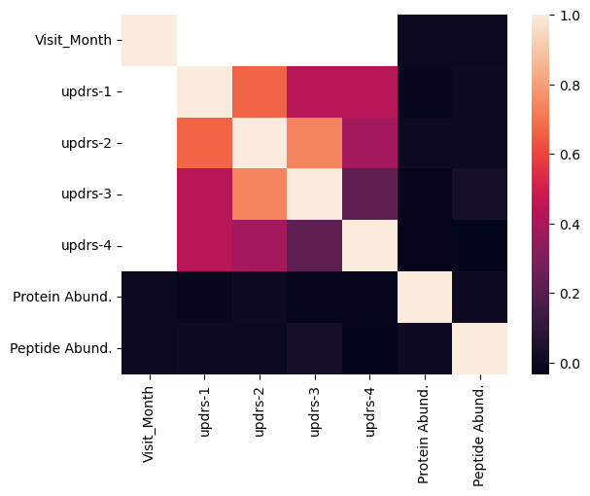
Correlation Matrix
There seems to be correlations among:
All the variables:
Peptide abundance &protein abundance
Visit month & peptide abundance
Visit month & NPX

Slide 17
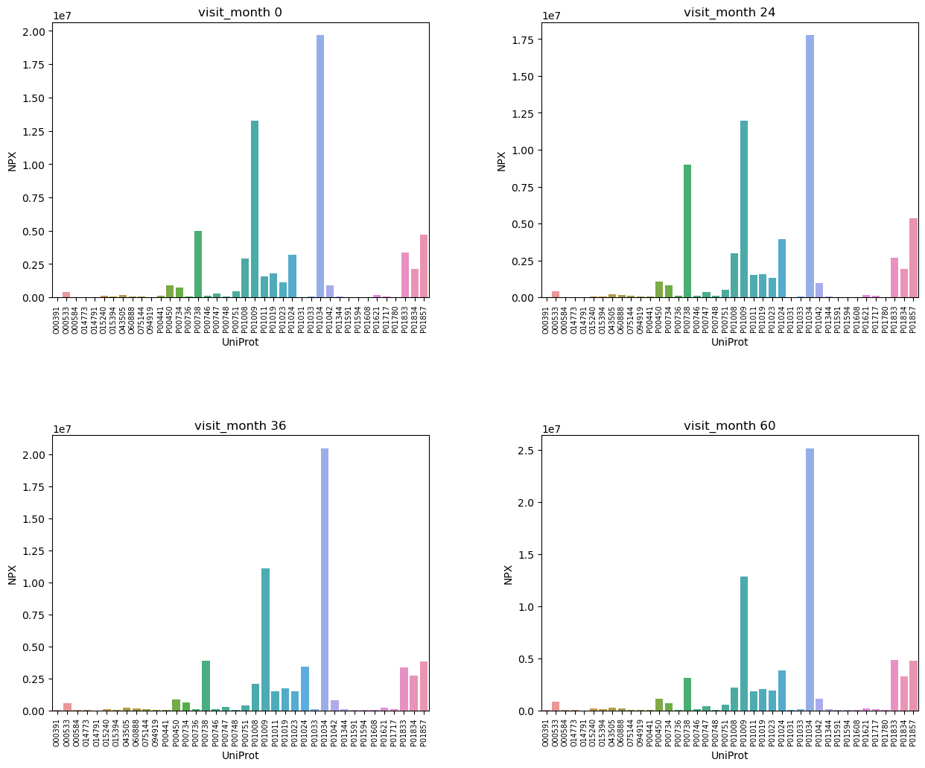
NPX (Protein Abundance vs Time for random patient= )

Slide 18
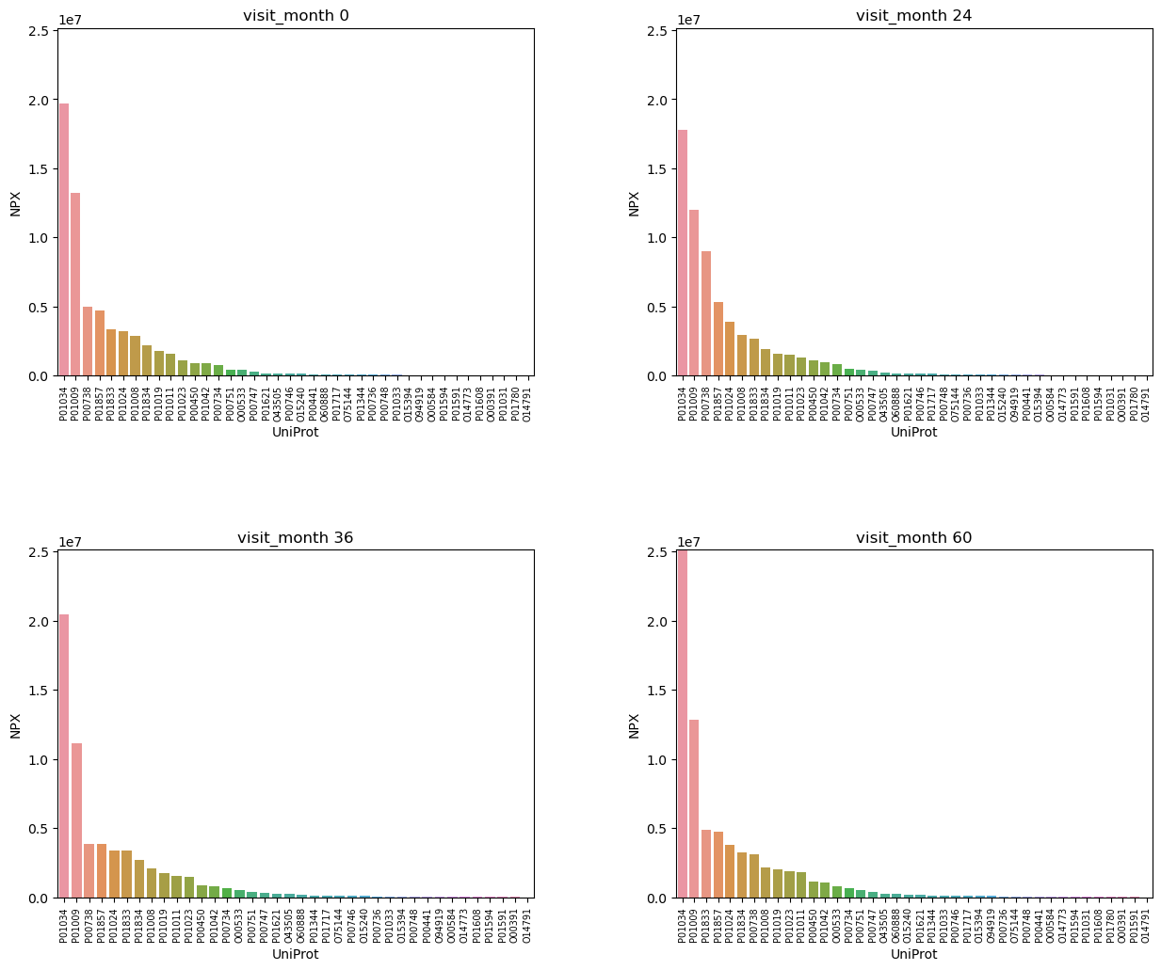
NPX (Protein Abundance vs Time for Random Patient=: )

Slide 19
Data Wrangling

Slide 20

def prepare_dataset(train_proteins, train_peptides): Step 1: Grouping df_protein_grouped = proteins.groupby(['visit_id','UniProt'])['NPX'].mean().reset_index() df_peptide_grouped = peptides.groupby(['visit_id','Peptide'])['PeptideAbundance'].mean().reset_index() Step 2: Pivoting df_protein = df_protein_grouped.pivot(index='visit_id',columns = 'UniProt', values = 'NPX').rename_axis(columns=None).reset_index() df_peptide = df_peptide_grouped.pivot(index='visit_id',columns = 'Peptide', values = 'PeptideAbundance').rename_axis(columns=None).reset_index() Step 3: Merging pro_pep_df = df_protein.merge(df_peptide, on = ['visit_id'], how = 'left') return pro_pep_df
GOAL 1 : Making a data frame with select features into columns!

Slide 21
PREPARING THE DATA SET Step 1: Grouping df_protein_grouped = proteins.groupby(['visit_id','UniProt'])['NPX'].mean().reset_index() df_peptide_grouped = peptides.groupby(['visit_id','Peptide'])['PeptideAbundance'].mean().reset_index()
Grouping
Obtain the desired columns from the desired data frames:
From proteins obtain visit_id, UniProt, and NPX
From peptides obtain visit_id, peptide, and PeptideAbundance
Do not forget to reset index

Slide 22
PREPARING THE DATA SET Step 2: Pivoting df_protein = df_protein_grouped.pivot(index='visit_id',columns = 'UniProt', values = 'NPX').rename_axis(columns=None).reset_index() df_peptide = df_peptide_grouped.pivot(index='visit_id',columns = 'Peptide', values = 'PeptideAbundance').rename_axis(columns=None).reset_index()
Pivoting
Make Uniprot and Peptide into features aligned as columns with the mean of NPX and mean of peptide abundance as the values respectively .
(Make Visit_Id the index to Merge on NEXT!)

Slide 23
PREPARING THE DATA SET Step 3: Merging pro_pep_df = df_protein.merge(df_peptide, on = ['visit_id'], how = 'left') return pro_pep_df
Merging
Left merge the newly made df_protein to df_peptide on Visit_Id
Get your new pro_pep_df

Slide 24
def prepare_dataset(train_proteins, train_peptides): Step 1: Grouping df_protein_grouped = proteins.groupby(['visit_id','UniProt'])['NPX'].mean().reset_index() df_peptide_grouped = peptides.groupby(['visit_id','Peptide'])['PeptideAbundance'].mean().reset_index() Step 2: Pivoting df_protein = df_protein_grouped.pivot(index='visit_id',columns = 'UniProt', values = 'NPX').rename_axis(columns=None).reset_index() df_peptide = df_peptide_grouped.pivot(index='visit_id',columns = 'Peptide', values = 'PeptideAbundance').rename_axis(columns=None).reset_index() Step 3: Merging pro_pep_df = df_protein.merge(df_peptide, on = ['visit_id'], how = 'left') return pro_pep_df
GOAL 2 : Obtaining Features

Slide 25

Obtaining Labels
Make a For Loop iterating over the newly made data frame.
Obtain all the features EXCEPT visit_id from the new data frame

Slide 26
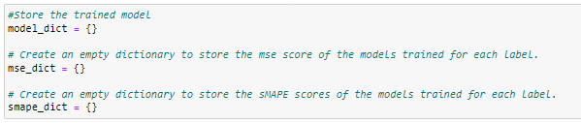
Initiating Empty Dictionaries
An empty dictionary to:
Store the model.
Store MSE score
Store sMAPE score

Slide 27
Preparing the Model & Modeling
Note: Modeling is done with help from TensorFlow to speed up the process

Slide 28

Preparing the General Model : Model 1
Create a loop to :
Part1
1. Define a Function to Split Data
2. merge
3. drop null values
4. Scale data
Part 2
4. split and train the data set
5. Convert the dataset pandas-> tensorflow for faster processing

Slide 29

Defining a Function to Split Data
Instead of using train_test_split I defined a function called split_dataset to split the dataset into two subsets by using random sampling:
A training set and a testing.
80% of the data will be be in the training
20% of the data will be in the testing set.

Slide 30

Initializing the Scaler

Slide 31

Initializing Target Labels

Slide 32
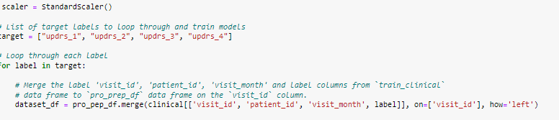
Initilizing Model through For Loop
Initiate a for loop to go through each target UPDRs (The target variables)
Merge the data frame you made recently to the clinical data frame on visit_id .
Make sure you add new columns: patient_id, visit_month, label.
Label refers to the target variables you are trying to predict ('updrs_1', 'updrs_2', etc.).

Slide 33

Removing NA Values
Missing Values will be dropped from label (UPDRs1-4)

Slide 34
Add Label to Features
New list of Features, to include label values

Slide 35
Data Scaling

Slide 36

Scaling: Standard Scaler
Scaling the data turns the data into a numpy array
Must turn df back into pandas df

Slide 37
Data Spliting and Training

Slide 38
Splitting into Test/ Train Data Set
Using the function defined earlier to split the data into 80%training data and 20% test data
Print the number of examples (rows) in the training and validation datasets

Slide 39
Convert into TensorFlow Data Set
tfdf.keras.Task.REGRESSION: Building a regression model
tffdf.keras.pd_dataframe_to_tf_dataset: Converts pd data frame into a tensor flow object
Data is handled in batches.
Data is shuffled
Label is target variable

Slide 40
Creating Model 1: Random Forest With Standard Scaler

Slide 41
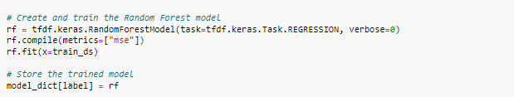
Creating Model 1
Define the random forest model for the tensor flow data frame
Specify MSE as the metric to be used for evaluating
Fit the model
Store the model

Slide 42
Evaluating Models
MSE: Used to evaluate the accuracy of regression models.
sMAPE :Used to evaluate the accuracy of regression models. It measures the percentage difference between actual and predicted values. The evaluation metric for this Kaggle competition

Slide 43
Evaluating Model 1

Slide 44

Evaluating Model 1:MSE
Call evaluation metric data
Evaluate MSE & Print
Store data in empty dictionary

Slide 45
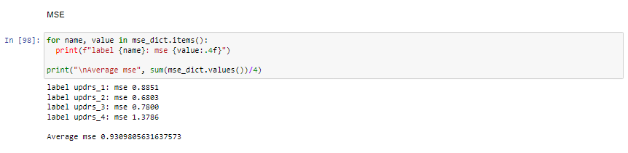
Evaluating Model 1: MSE Results
Run a for loop to print MSE values stored for Model 1
AVG MSE was 0.93
This is TOO close to 1.
The model is USELESS.

Slide 46
Evaluating Model 1:sMAPE Results
Call evaluation metric data
Evaluate MSE & Print
Store data in empty dictionary

Slide 47
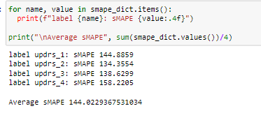
Evaluating Model 1: sMAPE
Run a for loop to print sMAPE values stored for Model 1
AVG MSE was 144.02
This is OVER 100.
The model is USELESS.

Slide 48
Model 2: Random Forest with RobustScaler

Slide 49
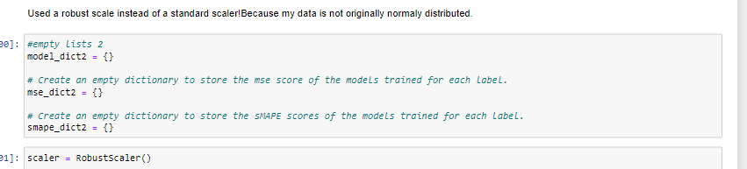

Model 2: Random Forest with RobustScaler
Follow all steps for Model 1:
Except:
Initialize new empty dictionaries for model 2
Use Robust Scaler instead of the StandardScaler

Slide 50
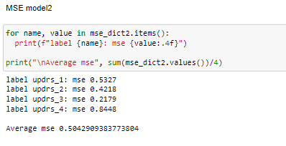
Evaluating Model 2: MSE Results
Run a for loop to print MSE values stored for Model 2
AVG MSE was 0.504
The MSE is 0.504.
The model may be considered predictive.

Slide 51
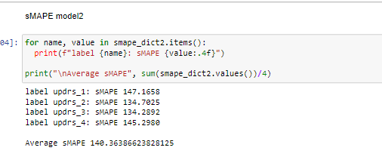
Evaluating Model 2: sMAPE
Run a for loop to print sMAPE values stored for Model 2
AVG MSE was 140.36
This is OVER 100, but better than 144

Slide 52
Model 3: Gradient Boosting Model
No Scaler

Slide 53
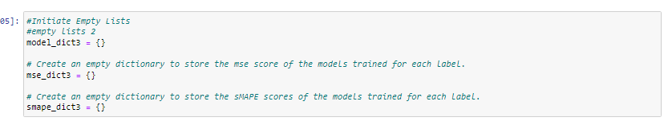
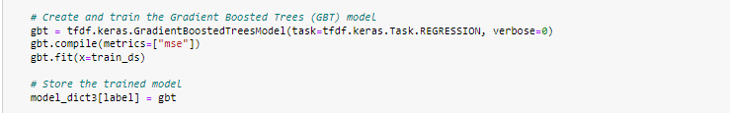
Model 3: Gradient Boosting Model (No Scaler)
Follow all steps for Model 1:
Except:
Initialize new empty dictionaries for model 3
Remove the scaler
Run GBM instead of Random Forest

Slide 54
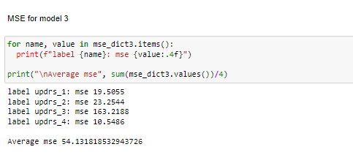
Evaluating Model 3: MSE Results
Run a for loop to print MSE values stored for Model 3
AVG MSE was 54.13
The MSE is 54.13. Since the model was NOT scaled, the model is on another scale.
The model may be considered predictive.

Slide 55
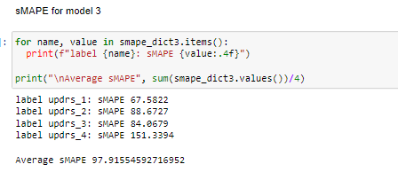
Evaluating Model 3: sMAPE
Run a for loop to print sMAPE values stored for Model 3
AVG MSE was 97.91
This is UNDER 100
Best score yet.

Slide 56
Model 4: Gradient Boosting Model
with Robust Scaler

Slide 57
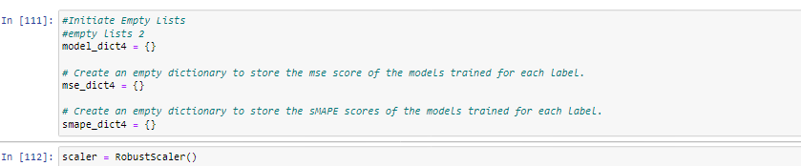
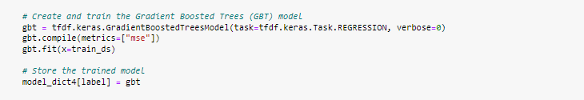
Model : Gradient Boosting Model (w RobustScaler)
Follow all steps for Model 3:
Except:
Initialize new empty dictionaries for model 3
Add RobustScaler

Slide 58
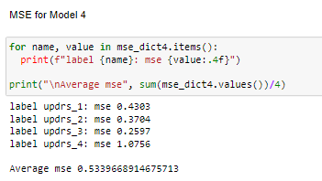
Evaluating Model 4: MSE Results
Run a for loop to print MSE values stored for Model 4
AVG MSE was 0.5333
The MSE is 0.5333. The model may be considered predictive. Second Best MSE score.
Note: This model took the longest to run!

Slide 59
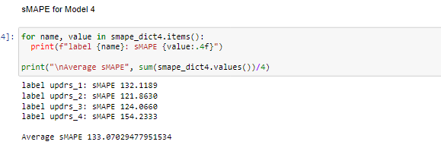
Evaluating Model 4: sMAPE
Run a for loop to print sMAPE values stored for Model 4
AVG MSE was 133.07
This is OVER 100
Best score yet.

Slide 60
Comparing Models

Slide 61
Model 3 VS Model 4
AVG sMAPE for model 3 was 97.91
AVG MSE for model 3 was 0.5333

Slide 62
Conclusion

Slide 63

Conclusion
The best model was a GBM without a robust scaler.
It had the lowest sMAPE Score.
(The metric for this competition)

Slide 64
End

